Slide 1
11th MEETING OF
THE IHO INTER-REGIONAL COORDINATING COMMITTEE
IHO-IRCC 11
Genoa, Italy
3-5 June 2019
ROPME Sea Area Hydrographic Commission (RSAHC)
Report

Slide 2
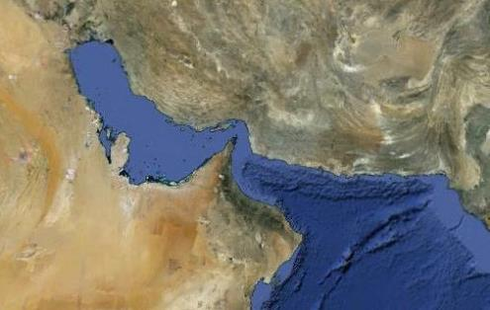
11th MEETING OF THE IHO INTER-REGIONAL
COORDINATING COMMITTEE
IHO-IRCC 11
Genoa, Italy 3-5 June 2019
ROPME Sea Area Hydrographic Commission (RSAHC)
The ROPME Sea Area Hydrographic Commission (RSAHC) was established in 2000 in Tehran, Iran during a meeting attended by delegations from Kuwait, Saudi Arabia, Bahrain, Qatar, Oman, UAE, and IR Iran as Member States, and Pakistan, United Kingdom, Canada, Yemen, MENAS, and IHO representatives as observers.

Slide 3
11th MEETING OF THE IHO INTER-REGIONAL
COORDINATING COMMITTEE
IHO-IRCC 11
Genoa, Italy 3-5 June 2019
Organization:
Chair: Mr. Ali Reza Khojatesh IR of Iran
Vice-Chair: Mr. Hamdan Al Yahmadi Oman
Full Members: Bahrain, IR of Iran, Kuwait, Oman, Pakistan, Qatar, Saudi Arabia, and United Arab Emirates (UAE)
Associate members: France, Iraq, United Kingdom, and United States of America.
Observers:
Regional Organization for the Protection of the Marine Environment (ROPME), Middle East Navigation Service (MENAS), International Association of Marine Aids to Navigation and Lighthouse Authorities (IALA), and Arabian Maritime and Navigation Aids Services LLC (AMNAS)

Slide 4
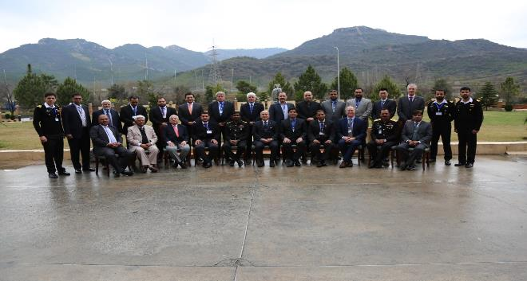
11th MEETING OF THE IHO INTER-REGIONAL
COORDINATING COMMITTEE
IHO-IRCC 11
Genoa, Italy 3-5 June 2019
Last Meeting: 8th meeting in Islamabad, Pakistan, 18-20 February 2019
Next meeting:
2nd extraordinary meeting of RSAHC may be scheduled prior to IHO Assembly Meeting in 2020
9th meeting will take place tentatively in February 2021 (the venue and exact date is to be determined subsequently).
Current RSAHC Working Groups:
RSA INT/ENC Chart Coordination working Group (RSAICCWG), Coordinator IR of Iran

Slide 5
11th MEETING OF THE IHO INTER-REGIONAL
COORDINATING COMMITTEE
IHO-IRCC 11
Genoa, Italy 3-5 June 2019
Capacity Building
Pursuant to the Action No. 11 of the IRCC 10 and correspondence coordination with the RSAHC Member States, Mr. Saeid Parizi from IR of Iran has been selected as permanent CB Coordinator for the RSAHC region since 2018.

Slide 6
11th MEETING OF THE IHO INTER-REGIONAL
COORDINATING COMMITTEE
IHO-IRCC 11
Genoa, Italy 3-5 June 2019
INT Charts Released by RSAHC Member States (Updated June 2019)
During the RSAHC8, Member States were reminded to:
- review their C-55;
- submit information in non-meeting years;
- vote on related matters as circulated through IHO Circular Letters, in a timely manner.
Country | Scheme | Released | Country | Scheme | Released
Bahrain | - | 5 | Saudi Arabia | - | 5
IR of Iran | - | 42 | Sultanate of Oman | 25 | -
Kuwait | 9 | - | UAE | - | -
Pakistan | 41 | 8 | UKHO | 19 | 83
Qatar | - | -
Submitted INT charts in IHO Web Chart Catalogue from Feb. 2017 to Feb. 2019 by Iran: Bahrain: 4 charts
GB: 19 Charts
IR: 8 Charts

Slide 7
11th MEETING OF THE IHO INTER-REGIONAL
COORDINATING COMMITTEE
IHO-IRCC 11
Genoa, Italy 3-5 June 2019
ENCs Released by RSAHC Member States
Country | Released | Producer | Country | Released | Producer
Bahrain | 8 | BH | Saudi Arabia | 5 | SA
IR of Iran | 76 | IR | Sultanate of Oman | 3 | SO
Kuwait | 3 | GB | UAE | 5 | GB
Pakistan | 7 | PK | UKHO | 105 | GB
Qatar | 16 | GB

Slide 8
11th MEETING OF THE IHO INTER-REGIONAL
COORDINATING COMMITTEE
IHO-IRCC 11
Genoa, Italy 3-5 June 2019
Action Required of IRCC:
The IRCC is invited to note this report and continue the capacity building support for RSAHC.

